Slide 1

Socioeconomic Survey Map Home Prices and Social Incomes

Slide 2
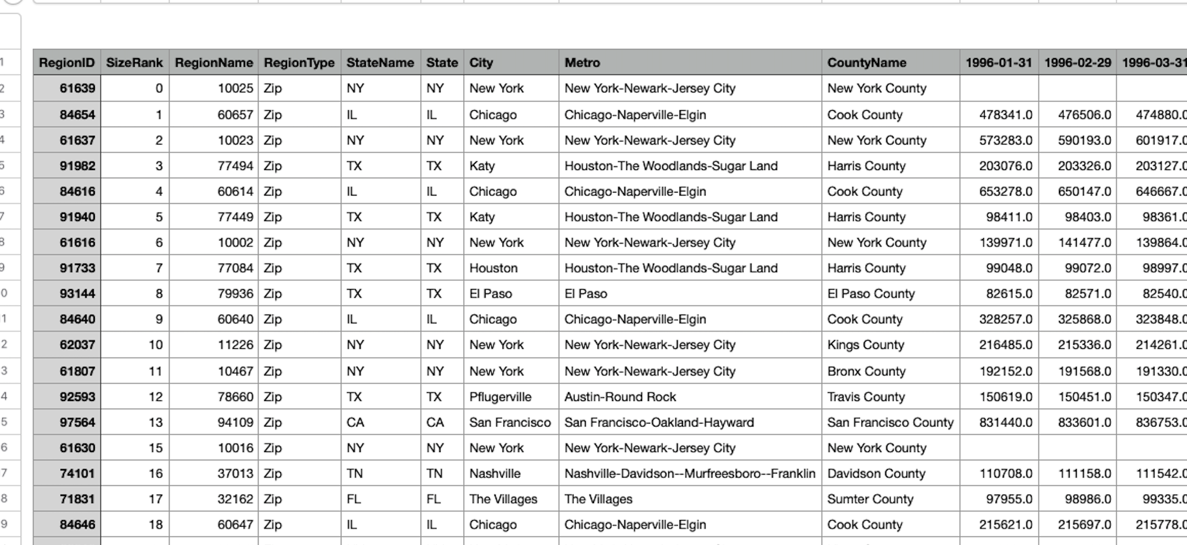


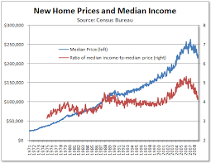

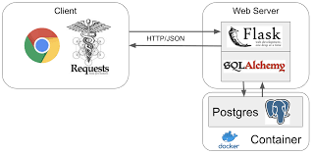
Team:
Billy Lau, Tim McCowan, John Hopkins
Topic: Home Prices and Social Incomes
Option 3 (A dashboard page with multiple charts that update from the same data)
Data Set 1 = Zillow
Data Set 2 = Open Data Soft
Data Set 3 = US Census
Technologies:
HTML & CSS JavaScript
Flask Routes
Postgress
Pandas
Architecture:

Slide 3
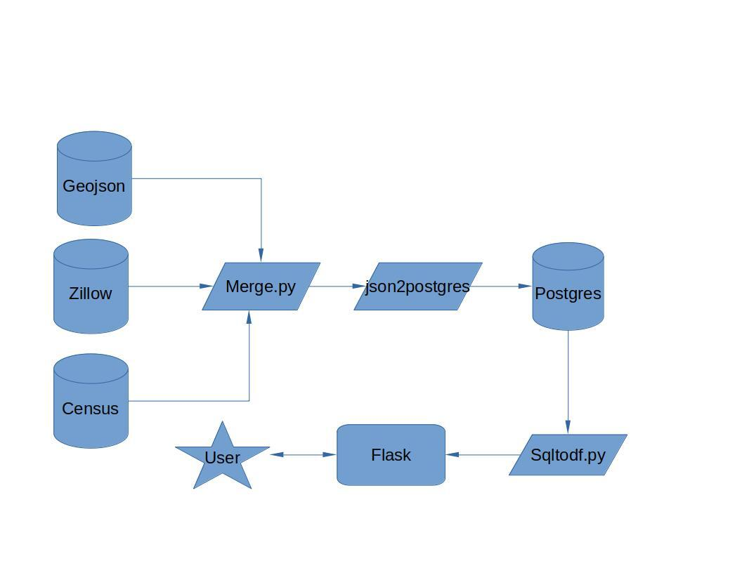

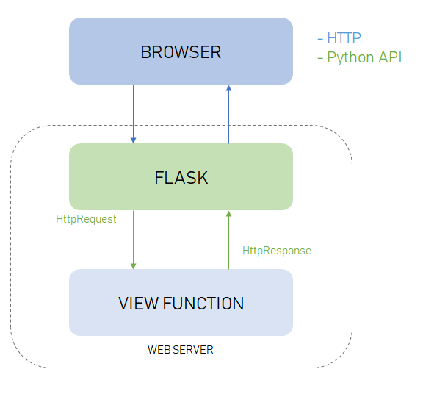
Home Prices and Social Incomes
Data Flow
Flask

Slide 4
Home Prices and Social Incomes
Data Sources:
Geojson - These data contain all 50 states with zip code as boarders. The data is extracted from https://github.com/OpenDataDE/State-zip-code-GeoJSON. This data is use in conjunction with Zillow data to map out housing prices.
Zillow api – We use this api to extract US housing price data per zip code. This data is merge with the Geojson data. This will allow us to create a heat map that outlines various area base on median single-family home.
Census api – We use this api to extract US population data base on zip code. This data is merge with the Geojson data and Zillow to have a complete picture of the Population demographics and housing prices.

Slide 5
Home Prices and Social Incomes
Extract, Transform and Load:
***geopandas is require for this process. Otherwise the data will not merge correctly***
Extract all data from the above data sources
Clean up column replace any spaces on the column name with underscore
Rename any column with zip code to ZCTA5CE10
**Note** Step 3 may not be necessary but since we are down a person and had no time to test. We just assume geopandas will be looking for that column, so we opted rename all zip code column.
Run merge.py to merge the 3 data into one large json file
Read data from geojson file of state with geojson
Read Zillow csv with pandas
Read census data with pandas
Create a data frame for both Zillow data and census data
Convert data type to string for column (ZCTA5CE10) **without this step data will not merge**
Merge Zillow data frame to geojson data
Convert data type to string for column (ZCTA5CE10) in cenus dataframe
Merge census date frame to geojson data
Write new file with Geojson driver. Not using this will cause issue
Load data into postgres database (json2postgres.py)
Read the merge json file (ga_merge.json)
Normalize the json data
Clean up data by dropping geojson columns such as geometry. Coordinates
Create an engine to connect to postgres db
Use the .to_sql method to to upload the database table
Clear connection
Generate visual with data (sqltodf.py)
Create an engine to connect to the database
Use the .execute method get data( select * form ga_merge)
Run the .execute method again with .key() **Note** Need both data and header. Otherwise you will numbers on your column name
Normalize the data
Create a data frame for the data
Rename the column from the results form .key() method
Create a data frame with poverty rate of over 20 percent
Run .dropna() no get rid of NaN
Remove crazy numbers such as (-666666666)
Get data frame stats. Use for sanity check
Create scatter plot with projection of housing prices of population with over 20% of poverty rate for the last 4 years.
Create 4 data frame with median housing price from the above data
Merge and create a bar graph to compare data
Re-run steps g-m for poverty rate under 10 percent (the rich people)
Now compare the 2 bar charts

Slide 6
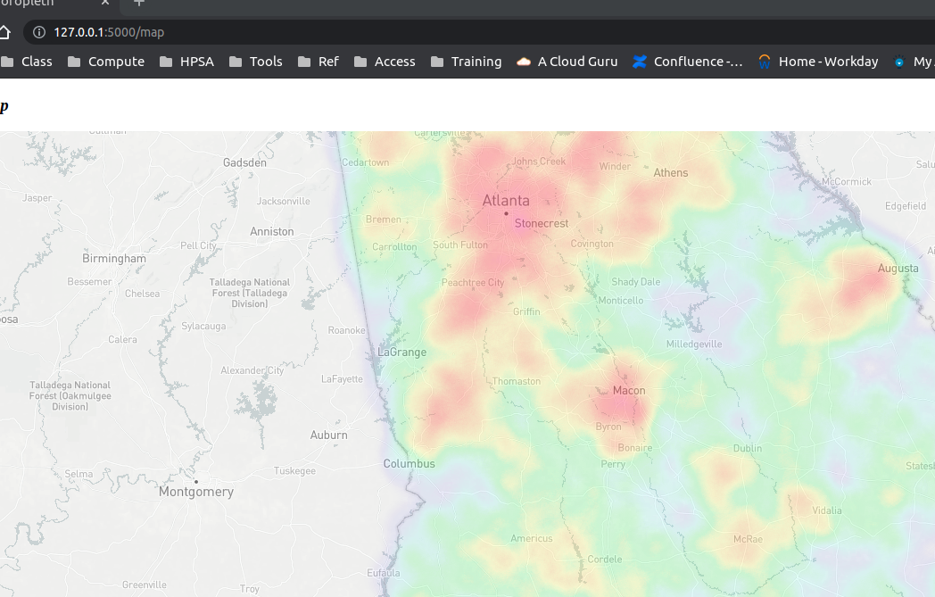
Home Prices and Social Incomes
Visualizing the Map:
Visual Map Layering
Need the following js preloaded – choropleth.js, leaflet-heat.js
Logic.js
Create a monthly payment function to check for mortgage
Create a createmap function to generate background maps
Create legend for the map and load
Load geojson data to d3.json to create function that will display city, county name, poverty rate into pop up.
Create list with data need to do mortgage math
Create heat map layer
Create popup for both layers

Slide 7
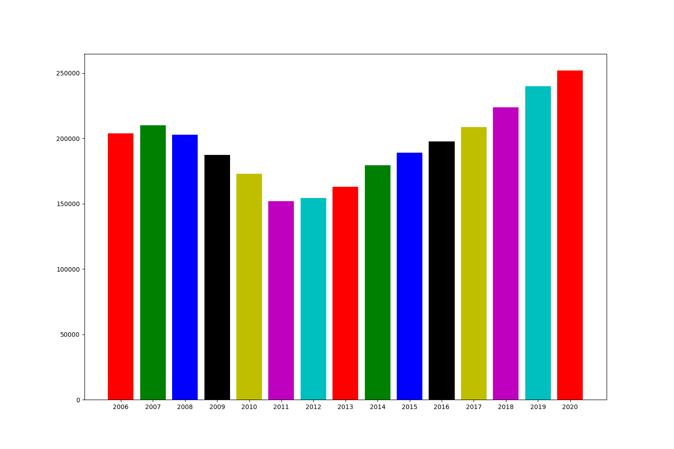
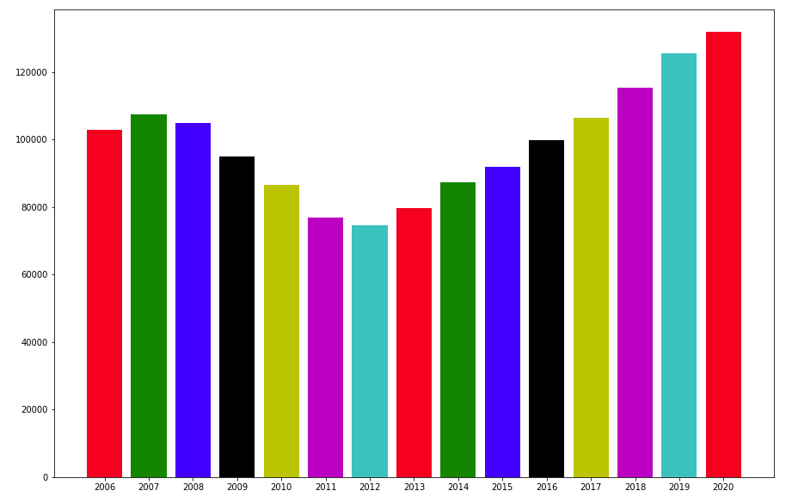
Home Prices and Social Incomes
Outcomes:
What Have We Discovered:
Housing trend for area with less than 10% poverty rate
Housing trend for area with less than 20% poverty rate

